Slide 1
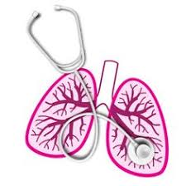
University of Basrah Al-zahraa medical college
Ministry of higher Education and Scientific Researches
MODULE: The Respiratory System
STUDY SESSION: 3
DURATION: 2hrs
Mechanics of Breathing & Lung FUNCTION TESTING
Module staff:
Dr. Hadeel S. Al Ali Dr. Kadhum Salih
Dr. Aamir Qasim Dr. Majid Hameed
Dr. Firas Muhammed Dr. Luma Ahmed
Dr. Ihsan Mardan Dr. Nawal Mustafa
Guyton, A.C., Human Physiology and Mechanisms of Disease, 13th Edition, W.B. Saunders, 2016, ISBN: 978-1-4557-7005-2.
Koeppen, B.M. & Stanton, B.A. Berne & Levy: Principles of Physiology, 7th Edition, Philadelphia, PA, 2018, ISBN: 978-0-323-39394-2.
For more discussion, questions or cases need help please post to the session group

Slide 2
Mechanics of Breathing

Slide 3
6- Put the following pressures in rank order from highest to lowest during inspiration: pressure in the alveoli; pressure at the mouth; pressure in the pleural space.
How will the above order change in
6.1. a quiet expiration to resting expiratory level?
6.2. a forced expiration?

Slide 4
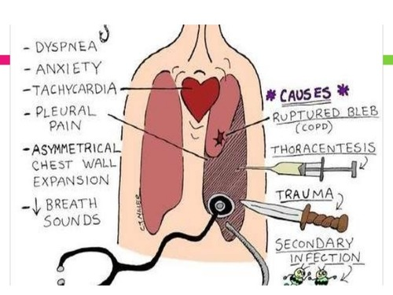
7- What will happen to the lungs if air is introduced into a pleural space? What is this condition called? How might you treat it?

Slide 5
8- What will happen to the resting expiratory level (functional residual volume) if
8.1. the lungs become stiffer because of the development of fibrous tissue
8.2. the lungs become more compliant.

Slide 6
9- In what conditions will the lungs become easier to stretch?

Slide 7
10- What might happen to the Functional Residual Capacity if narrowing of the small airways makes it more difficult to force air through them when they are compressed during expiration? What effect will this change have on the shape of a patient’s chest?

Slide 8
11- You measure an adult's Vital Capacity and find that it is only about half what you would expect for that individual. List some possible reasons for this.
(Hint: Look at the tracing of lung volumes & capacities; what volumes add up to make the Vital Capacity? How these could factors be affected)

Slide 9
12- What will happen to the compliance of the lungs in Respiratory Distress Syndrome? Describe the movements of the chest wall in a baby with respiratory distress syndrome, and explain what you describe.

Slide 10
13- In the normal lung, where in the airways is the highest flow resistance
13.1. in peak inspiration?
13.2. During a forced expiration?

Slide 11
14- Why do we tend to breathe through our mouths in exercise?

Slide 12
MCQ |  |  | T |  | F
1 | The lungs expand if removed from the body. | [ | ] | [ | ]
2 | Air in the pleural space will reduce vital capacity. | [ | ] | [ | ]
3 | If the diaphragm contracts lung volume will increase. | [ | ] | [ | ]
4 | In a forced expiration the diaphragm is driven into the thorax by contraction of the intercostal muscles. | [ | ] | [ | ]

Slide 13
1 | The compliance of the lung is the pressure change per unit | [ | ] | [ | ]
 | volume change.
2 | Lung compliance is greater if the lungs are expanded nearly | [ | ] | [ | ]
 | completely than if they are at low volume.
3 | If the compliance of the lungs increases, pressure at any given lung volume, will be higher. | [ | ] | [ | ]
4 | Fibrosis of the lung decreases compliance. | [ | ] | [ | ]

Slide 14
1 | Surfactant is secreted by type II alveolar cells. | [ | ] | [ | ]
2 | Surface tension forces increase at high lung volumes | [ | ] | [ | ]
3 | The surface tension of the fluid lining the lungs at any given volume is greater when the lung is being | [ | ] | [ | ]
 | expanded than when it is recoiling.
4 | Absence of surfactant reduces the number of alveoli in the lungs. | [ | ] | [ | ]
5 | Absence of surfactant leads to greater inspiratory effort. | [ | ] | [ | ]

Slide 15
1 | Air flow in the trachea is always laminar. | [ | ] | [ | ]
2 | The resistance to air flow through the bronchioles is greater in expiration than in inspiration. | [ | ] | [ | ]
3 | The resistance to air flow would be increased by inhalation of a ß₂ adrenoreceptor agonist. | [ | ] | [ | ]
4 | Partial occlusion of a large airway will reduce maximum flow in expiration. | [ | ] | [ | ]

Slide 16
Lung FUNCTION TESTING

Slide 17
1- Sketch what will happen to the vitalograph trace of a patient with emphysema.

Slide 18
2- Sketch what will happen to the vitalograph trace of a patient with mild asthma

Slide 19
3- Sketch the expiratory flow volume loop for a patient with a tumour obstructing a main bronchus.

Slide 20
4- Sketch the expiratory flow volume loop for a patient with restrictive lung disease.

Slide 21
